Slide 1
Python Introduction
Attila CEFFER: ceffer@hit.bme.hu
Agil YOLCHUYEV: yolchuyev@hit.bme.hu
Budapest University of Technology and Economics

Slide 2
Overview
Background
IDE/Editors
Types
Operators/ Loops/Control Flow
Functions
Libraries

Slide 3
What is Python?
Python is high level programming language. Python can be used to develop desktop GUI applications, websites and web applications, scientific applications.

Slide 4
Why Python?
Python is compatible with numerous platforms, so a developer doesn't have to bother about any issues which often occurs with other languages.
Python supports procedure-oriented as well as object-oriented programming.
Python has huge pile of various libraries, such as NumPy, SciPy, BeautifulSoup, SQLAlchemy, Matplotlib and so on…
Python is a dynamically-typed language. You can announce variable wherever you want and which type you want
Python meets “Less Code, Less Time” principle.

Slide 5
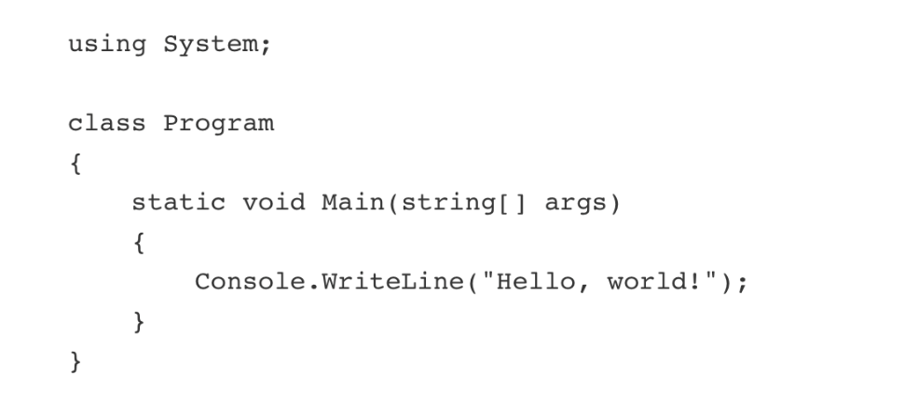
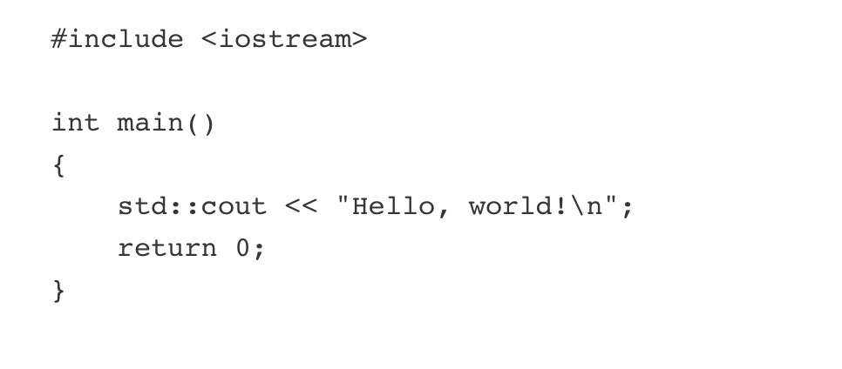
Hello World
C#
C++
Python

Slide 6
IDE/Editors
VIM – Default Editor can be used in linux
Nano – Another Command line linux editor
Pycham- Professional Python IDE: Professional and Community Editon
Jupyter – Web Based application for creating live based python code

Slide 7
Jupyter Notebook
Download and Install Python:
Mac:
brew install python
Windows:
Tradiotional next -> next -> next ☺
Install Jupyter:
For python3:
python3 -m pip install --upgrade pip
python3 -m pip install jupyter
To start Jupyter:
jupyter notebook
To install packages:
pip install package_name
conda install package_name

Slide 8
Installing packages in Python
Check Library package was installed:
Alternatively:

Slide 9
Run Jupyter Online
https://colab.research.google.com/notebooks/welcome.ipynb

Slide 10
Jupyter Interface

Slide 11
Python Types
Type Name | Character | Example
Number | Maximum size 2^63 - 1 | my_number = 1
List | Mutable type – max size 4294967295 | ex_1 = [] ex_2 = [‘1’,’2’,3]
String | Immutable Type – no maximum limit | ex_1 = ‘hello world’
Dictionary | Mutable – Key value principles, key should be immutable | tt = { ‘name’:”Agil”, “age”:[1,2,3,4] }
Set | Unique values | my_set = {1, 2, 3}
Tuple | Immutable list | my_tuple = (1,2,3,4)
Bool | Logical operations | My_bool=True

Slide 12
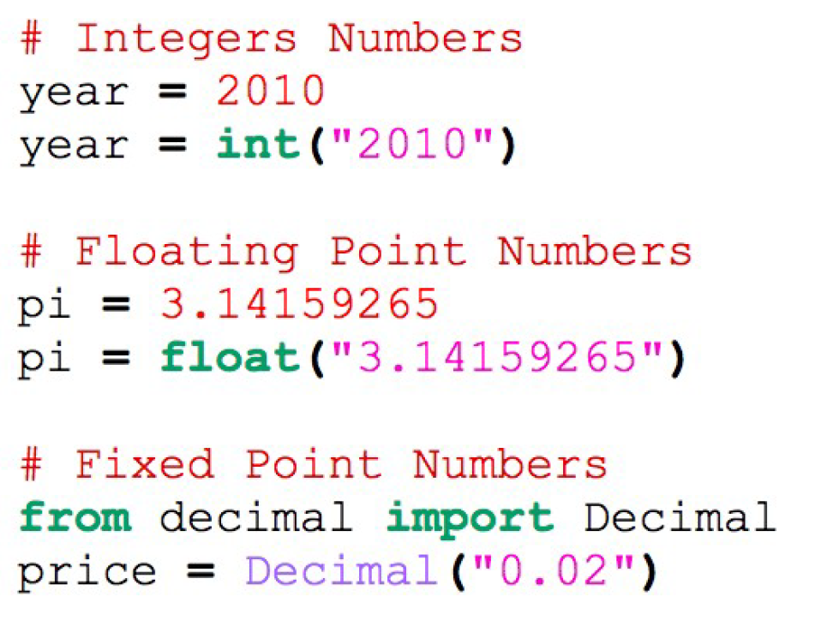
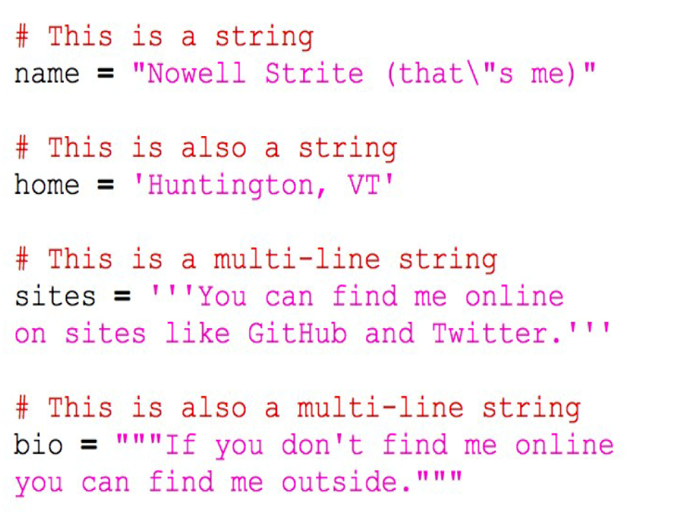
Basic Types and Operations
Number:
String:
Python String Basics:
https://www.programiz.com/python-programming/string

Slide 13
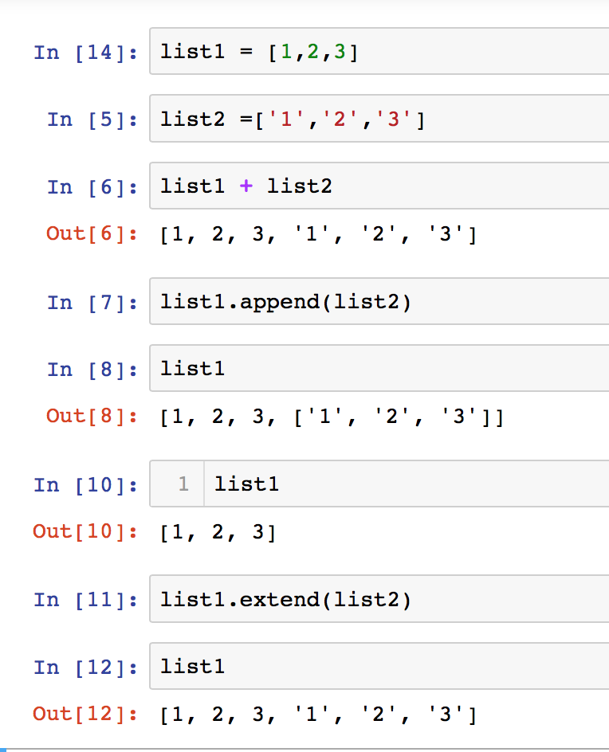
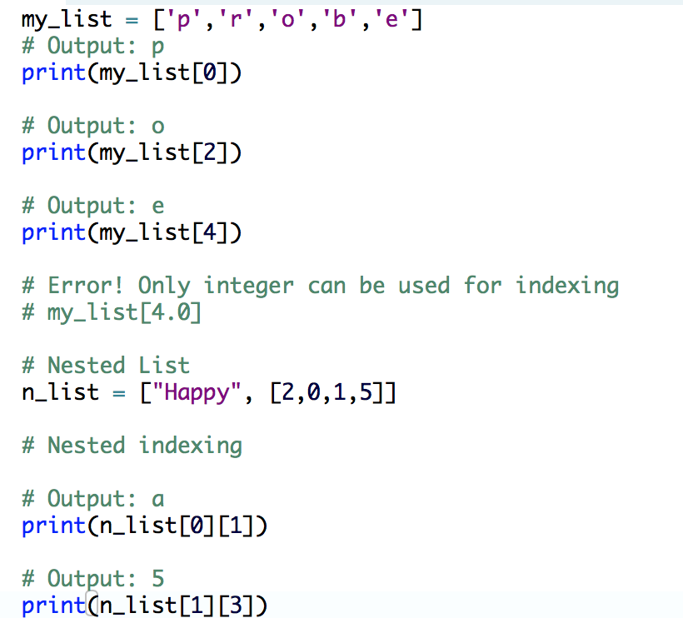
Basic Types and Operations
List1:
List2:
Python list basics:
https://www.programiz.com/python-programming/list

Slide 14
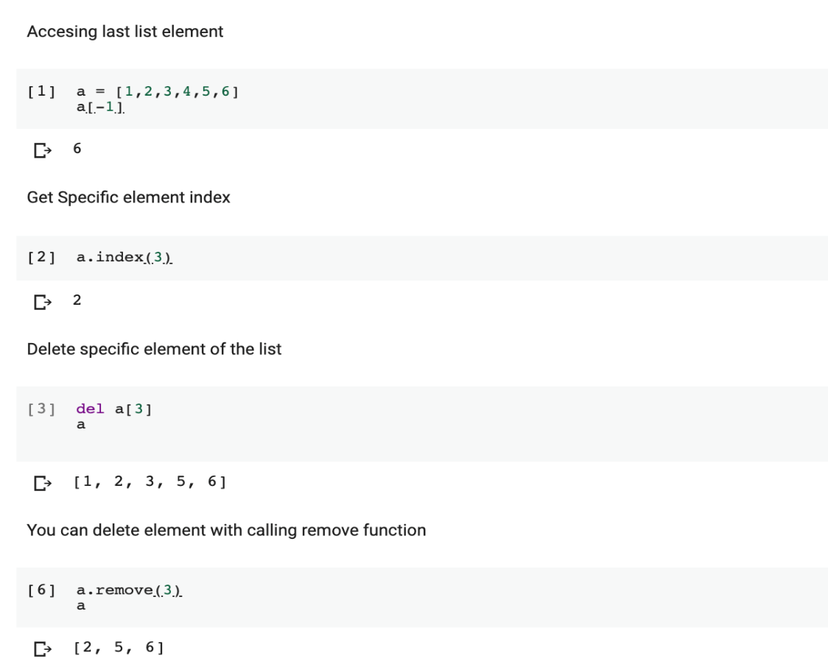
Basic Types and Operations

Slide 15
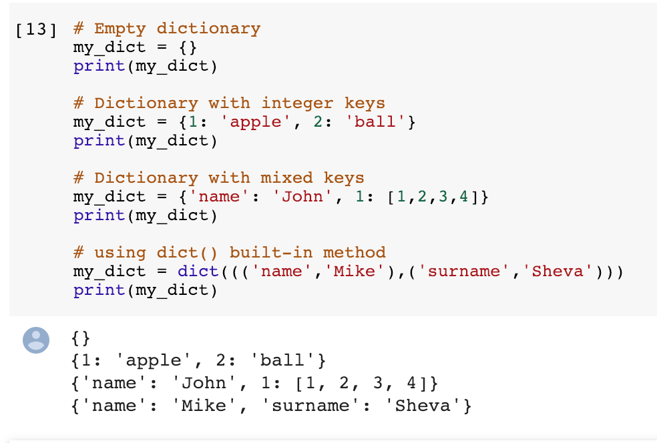
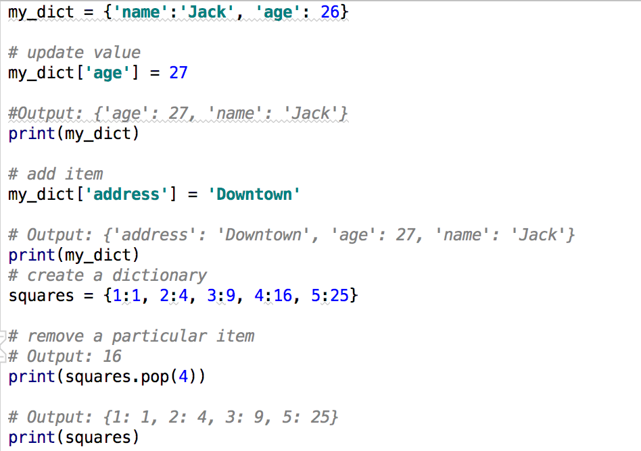
Basic Types and Operations
Dictionary 1:
Dictionary 2:
Python list basics:
https://www.programiz.com/python-programming/dictionary

Slide 16
Basic Types and Operations
Set
Python list basics:
https://www.programiz.com/python-programming/set

Slide 17
Operations

Slide 18
Python Loops and Flow Control

Slide 19
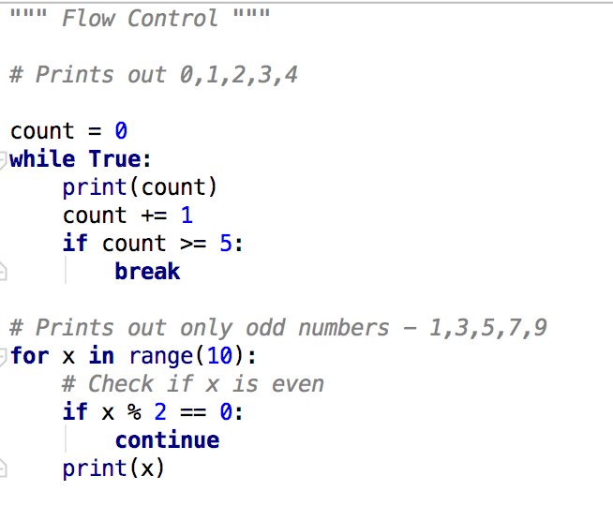
Python Loops and Flow Control

Slide 20
Python If, IF-ELSE-IF Statement

Slide 21
Python single line operations

Slide 22
Python Comments and Sensitivity

Slide 23
Python Functions

Slide 24
Python Built-in Functions

Slide 25
Python Built-in Functions

Slide 26
Python Built-in Functions

Slide 27
File Operations

Slide 28
Python Modules and Libraries
There are lots of standard and a new developed packages by python community. Search some built-in packages:
https://docs.python.org/3/library/
Example For Most Used Python libraries in science:
Numpy
Scipy
Matplotlib
Pandas

Slide 29
NumPy

Slide 30
NumPy Example

Slide 31
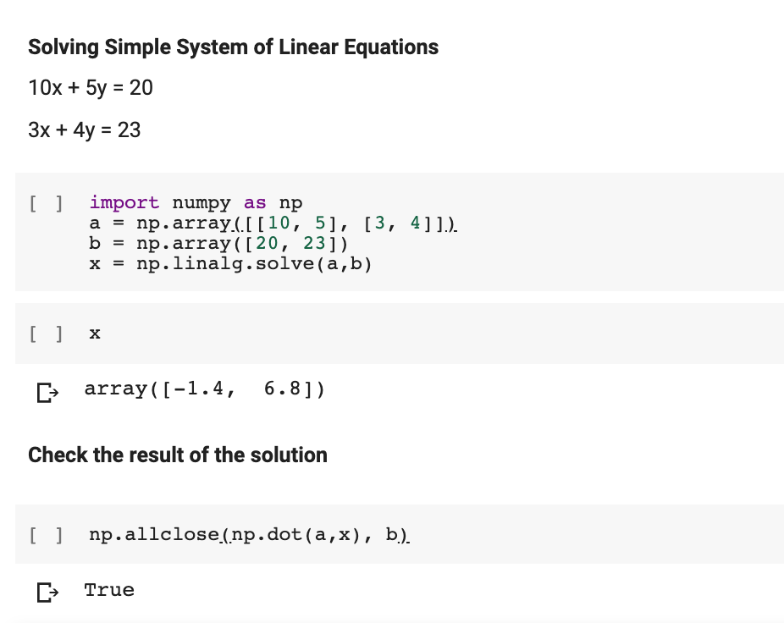
NumPy Example

Slide 32
NumPy Example

Slide 33
Matplotlib

Slide 34
Pandas

Slide 35
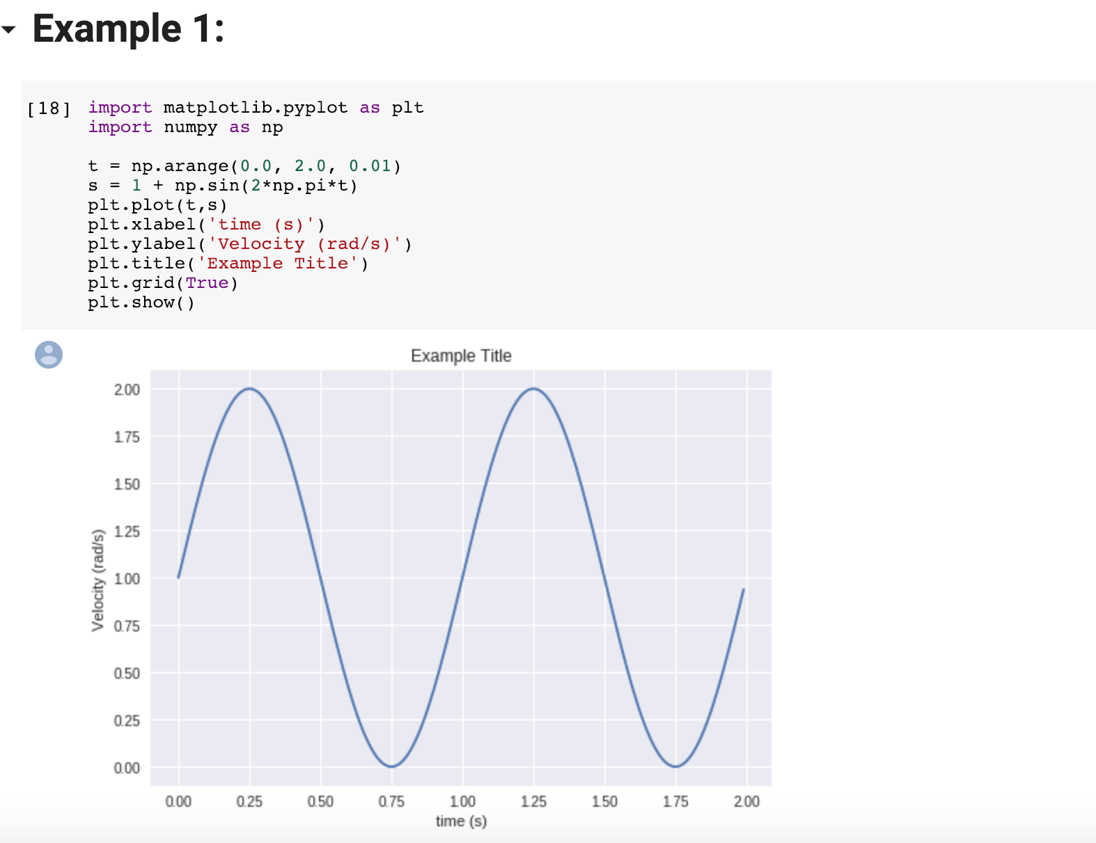

Slide 36
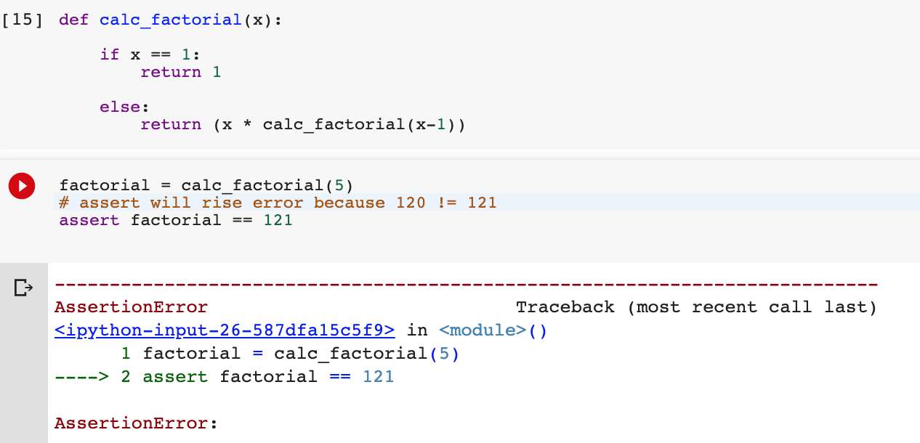
Basic Testing

Slide 37
Task
Write a program to compute the multiplication of two given matrixes.
Input Data: p = [[1, 0], [0, 1]] , q = [[1, 2], [3, 4]]
Write a program to compute the eigenvalues and right eigenvectors of a given square matrix
Input Data: [[3 , -2],[1, 0]]

Slide 38
Useful links
1. Learn Basics of the Python:
https://www.learnpython.org/
2. Learn Numpy:
https://realpython.com/how-to-use-numpy-arange/
3. Some Examples about numpy:
https://www.w3resource.com/python-exercises/numpy/
4. Learn Matplotlib:
https://realpython.com/python-matplotlib-guide/

